Slide 1
Welcome to all
for the PSK Online lecture
Chapter 3
Scientific Purchasing
By
Dr. Dhiraj Ovhal
HOD of Commerce

Slide 2
Q.6 Types of Purchasing polices
Meaning:- Purchasing means buying the materials.
The term "purchasing" simply describes the process of buying but in a broader sense, the term involves determining the need, selecting the supplier, arriving at proper price, terms, and conditions, issuing the contract or order and following up to ensure proper delivery Importance of Purchasing.
Definition
Scientific purchasing means To purchase Right material at right time at right source from right quality with right terms and conditions
Principles or Objectives or "7 R"S

Slide 3
Mobile Purchasing :- Online Buying
Mobile Purchasing :- Offline Buying
Mobile Purchasing :- Exchange ( Old and New)
Mobile Purchasing :- Family – Reciprocal buying

Slide 4
Q.6 Types of Purchasing polices
Speculative buying :-
Conservative Buying:-
Reciprocal buying:-
Concentrated buying:-
Diversified buying:-

Slide 5
Speculative buying :-
buy at low price to sell high price in the market
Share Market

Slide 6
2 Conservative Buying :-
Buy at only when it is required

Slide 7
3 Reciprocal buying:-
:- Any arrangement under which a seller of one product or service buys another product or service from one of his customers.
As a result of the agreement, both parties secure something they need and benefit from the terms of the contract. With corporations, a reciprocal agreement may involve cooperation on specific projects that will ultimately benefit both companies.

Slide 8
4. Concentrated buying:- :-
All or large quantities buy from one or selected supplier to save transport and material handling cost and saving in the price. large scale buying provide benefits.

Slide 9
5. Diversified buying :-
buy material from different supplier with flexibility

Slide 10
6. Hedging :-
A buying hedge is a transaction which commodities investors undertake to hedge against possible increases in the prices of the actual materials underlying the futures contracts

Slide 11
7. Tender System :-
Tendering usually refers to the process whereby governments and financial institutions invite bids for large projects that must be submitted within a finite deadline.
Metro project :- Reliance Infrastructure and L&T bagged two packages each. Reliance Infra participated in the bidding in joint venture with Italy-based Rizzani de Eccher S.p.A (RdE). According to knowledgeable sources, the contracts won by each company is in the range of ₹1,200-1,400 crore.
Bullet train project :-

Slide 12
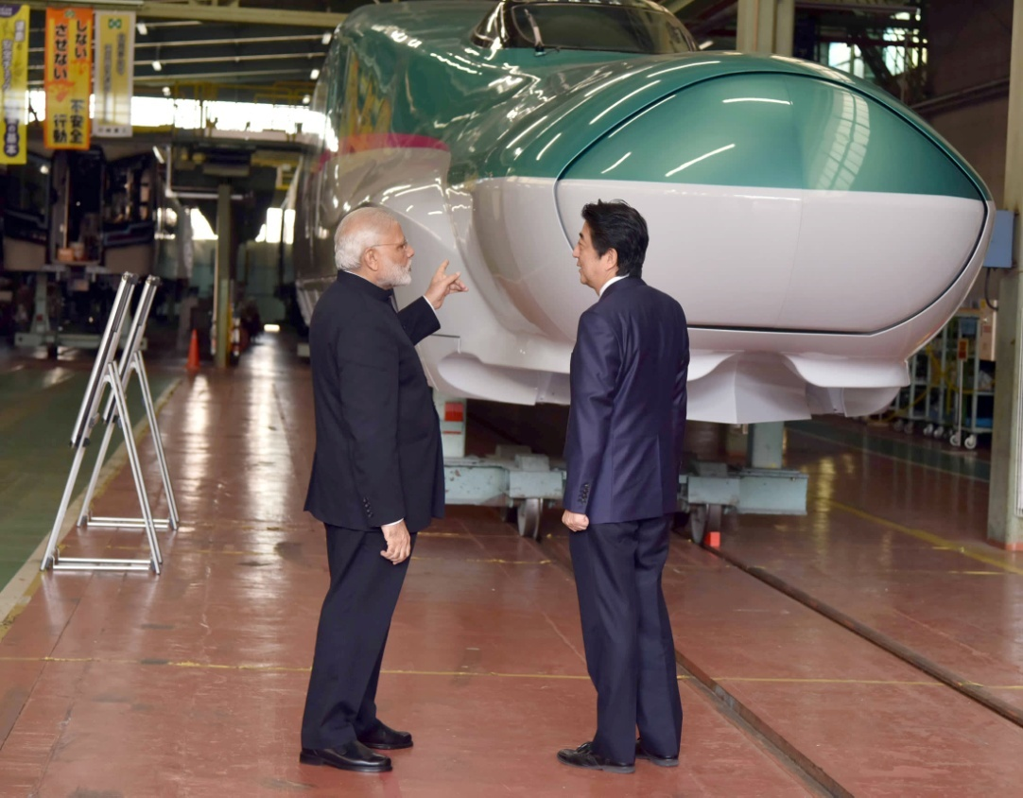
7. Tender System :-
The project involves the construction of a 505 km line connecting Ahmedabad in the western state of Gujarat and the country's commercial capital Mumbai using Japan's shinkansen technology, shortening the journey time between the two to just over two hours

Slide 13
8. Online Buying :-
Use Online platform or E-Platform to purchase material from supplier through online order
B2B

Slide 14
9. Petty Cash Buying :-
Small amount of purchasing such as Stationary , Paper, refill, recharge, etc.
These are trifles items and used petty cash

Slide 15
Q.5 Scientific Purchasing ?
Right quality
Right quantity
Right Price
Right Place Q² P² T² S
Right Time
Right Transport
Right Source

Slide 16
Thank You

Slide 17
Attendance Link
https://forms.gle/Xqvykv5vfEi1zpyF7
(Mention date at last point)

